Slide 1
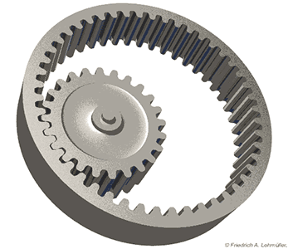
Leveraging AI for Enhanced System Dynamics
By
Shiva Bharathi M AI&DS Department-II Year Sengunthar Engineering College(Autonomous)

Slide 2
What is System Dynamics?
System dynamics is a methodology for modeling and simulating complex systems over time.
System dynamics is particularly useful for modeling systems that are nonlinear, complex, and dynamic systems. It can be used in a variety of fields, including engineering, economics, and social sciences.
Feedback loops in system dynamics are recurring patterns of interdependent cause-and-effect relationships that can either reinforce or counteract changes in a system.

Slide 3
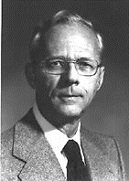
History of System Dynamics
System dynamics originated in the field of cybernetics in the mid-20th century, pioneered by Jay Forrester at MIT in the 1950s and 1960s.
Early applications of system dynamics included the study of industrial processes, urban planning, and environmental sustainability.
Today, system dynamics is widely used in fields such as economics, engineering, and public policy to model and simulate complex systems over time.
Prof. Emeritus Jay W. Forrester

Slide 4
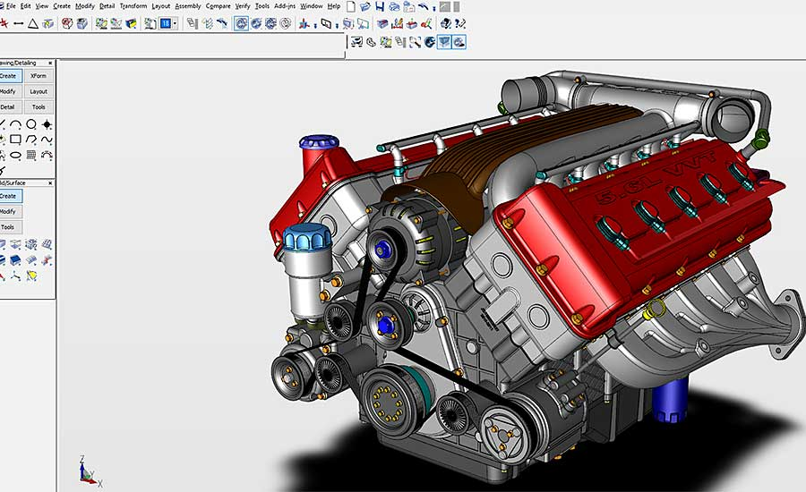
System Dynamics in Computer-Aided Design
System dynamics can be applied to computer-aided design, allowing for the modeling and simulation of complex systems in the mechanical and electrical domains.
Dynamic Modeling and Simulation
Interconnected Feedback Loops
Optimizing Performance
Decision Support

Slide 5
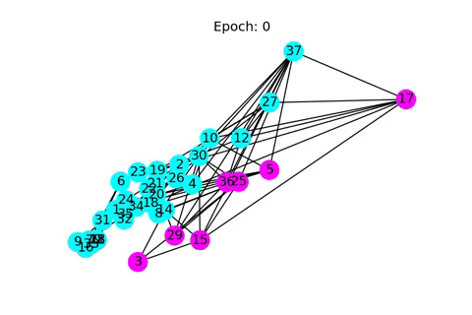
How Generative AI is Revolutionizing Computer-Aided Design
Generative AI is a technology that creates new data, such as images, text, or music, based on patterns it has learned from existing data.
Deep Learning Algorithms:
Generative Adversarial Networks (GAN)
Variational Autoencoders (VAE)
Recurrent Neural Networks (RNN)
Long Short-Term Memory (LSTM) Networks
Transformer Models(ChatGPT)

Slide 6
Applications
(Case 1): Developing innovative Design
(Case 2): Improvising the existing Model

Slide 7
System Dynamic Modelling
Define the Goal clearly
Detailed Design Specifications(3D or 2D)
Analyse and Extract Key Variables
Find relationships between Key Factors
Prepare Dataset based on the variables
Feed to our AI models
Filter the AI Generated Results
Manufacture and Test the Design
Iterate(If needed)

Slide 8
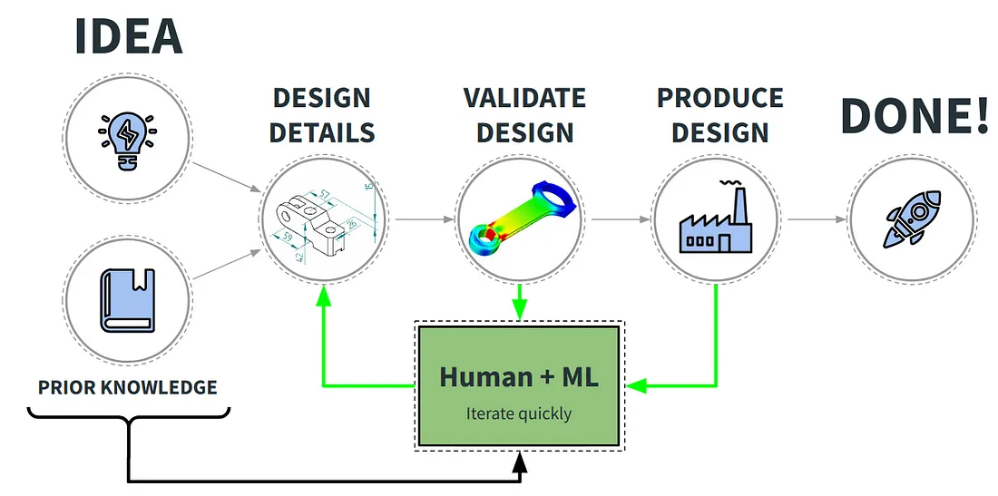
End to End Process: Optimized Design
The integration of generative AI with system dynamics can enhance modeling and simulation capabilities for complex systems, allowing for more accurate predictions and insights.

Slide 9
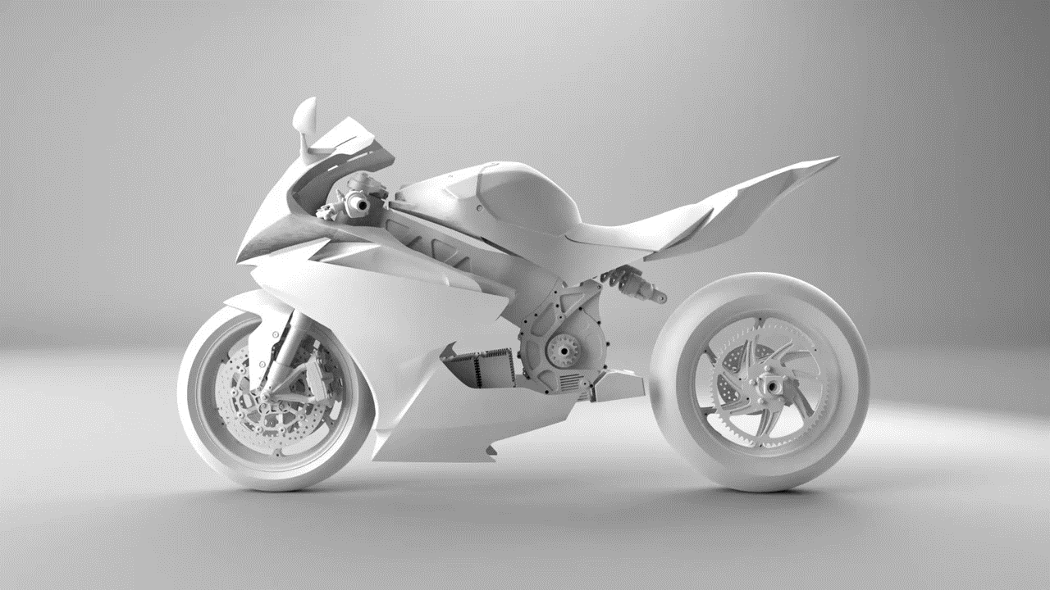
Generative Designs for Rear Chassis

Slide 10
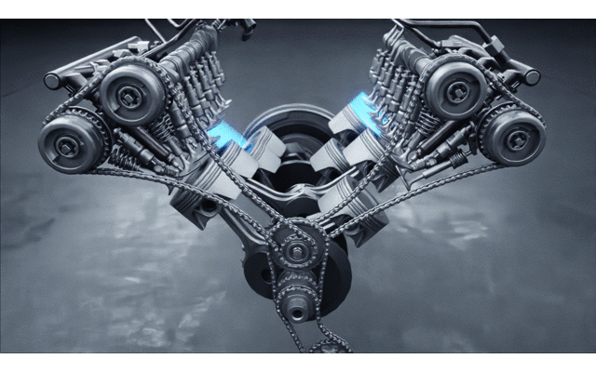
Improvising the existing system: The Internal Combustion Engine
Variables and Factors:
Time (t)
Engine Speed (ES)
Temperature (T)
Fuel Input (FI)
Efficiency (E)
Wear and Tear (WT)

Slide 11
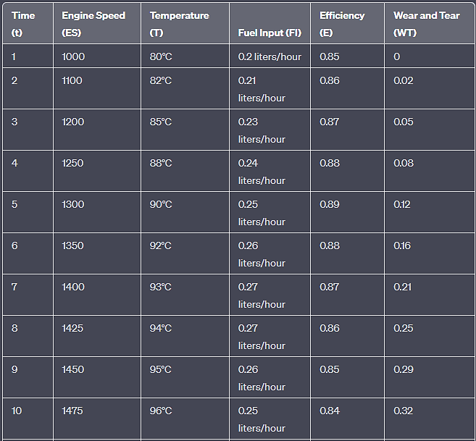
Example: Simple Dataset
This dataset includes variables such as engine speed, temperature, fuel input, efficiency, and wear and tear, representing the dynamic behavior of the engine over time. Such data can be used for AI training to develop predictive models for engine performance, maintenance, and optimization

Slide 12

Eg(1): In Electrical Domain
System dynamics can help designers to model and analyze the behavior of complex electrical systems, such as power grids and control systems, over time.

Slide 13

Eg(2): Economy of a Country
KEY VARIABLES
1. Gross Domestic Product (GDP)
2. Inflation Rate
3. Unemployment Rate
4. Interest Rates
5. Exchange Rates
6. Government Fiscal Policy
7. Monetary Policy
8. Trade Balance
9. Consumer Confidence
10. Business Confidence
11. Political Stability
12. Global Economic Conditions
13. Technological Advances
14. Demographics growth
15. Social and Environmental Factors
16. Energy Prices
17. Commodity Prices
18. Geopolitical Events

Slide 14
Pros and Cons
Pros
Complex Systems Modeling
Design Exploration
Innovation and Creativity
Reduced Time and Costs
AI-Enhanced Expertise
Enhanced Decision-Making
Cons
Data availability
Complexity of System Dynamics
Interdisciplinary Knowledge
Analysing the key factor
High Computational Demands

Slide 15

ANY Queries?
For Further Reference

Slide 16
Thank You😊

